Slide 1


Master’s Thesis AI Models for Improving and Optimizing Customer Support Efficiency
Student PANAIT Tudor-Alexandru
Scientific coordinator Conf. Univ. Dr. BUȘU Mihail

Slide 2

About Me
Current Roles:
CTO at Pickado
Technical Trainer at Lenovo USA
CEO at Feather
Focus Areas:
AI & Machine Learning
Customer Experience & Support
Product Design & Management
Education & Enablement
What Drives Me:
Making complex tech simple, useful and meaningful

Slide 3
Motivation
Traditional systems struggle with response time, consistency, and 24/7 availability
The rise in customer support demand requires scalable and efficient solutions
Businesses increasingly seek to reduce operational costs while maintaining high customer satisfaction
SMEs often lack resources for advanced tech and bigger support teams
Research explores how and if AI can help through a practical, data-driven analysis

Slide 4
Research Questions & Objectives
AI Use Cases
What are the most common and high-impact applications of AI in customer support?
Model Integration
How are different AI models (e.g., LLMs, embeddings, speech recognition) integrated into real-world support workflows?
Implementation Insights
What practical challenges and benefits have been observed in current AI implementations?
System Design
How can modular tools be assembled to build intelligent, multi-modal, context-aware support systems?
Evolution Toward Agentic AI
How can support operations progress from basic automation to more sophisticated agentic AI systems?

Slide 5
Methodology
Exploratory research based on secondary sources, practical case studies and functional prototypes
Sources Used
Academic literature (peer-reviewed articles, preprints)
Industry sources (whitepapers, vendor blogs, product docs)
Real-world case studies (e.g., OpenAI, Intercom, Zendesk)
Steps Taken
Identified key AI use cases in support (chatbots, transcription, etc.)
Selected and analyzed real-world implementations
Cross-checked claims across multiple sources
Prototype Development
Built 10 working demos using: Python, Streamlit, LangChain, FAISS, OpenAI API, Whisper
Simulated evolution from basic automation to agentic AI
Focus on feasibility & functionality, not benchmarking

Slide 6
Case Study Insights
Company | Use Case | Cost Impact | CSAT Impact
Bank of America | Chatbot (Erica) | +19% revenue | 98% resolution
Vodafone | Chatbot (TOBi) | 70% ↓ cost/chat | +14 NPS
Klarna | AI Bot Support | $40M saved | ↓ wait time to 2 mins
H&M | Retail Chatbot | 20% ↓ cost | +35% CSAT
British Telecom | Agent Assist | ↑ FCR +8% | +5% NPS
Temu | Returns Chatbot | Automated refunds | ↑ Loyalty
BT | AI KB (David) | $60K/month saved | ↑ Faster responses
4 analyzed categories:
AI Powered Chatbots
AI Enhanced Knowledge Base
AI for Call Analysis & Voice Support
AI in Returns and Refunds
Companies are leveraging AI to improve response time, lower costs, and boost satisfaction.
Case studies span banking, telecom, e-commerce, healthcare, and retail.
Each shows unique strengths, outcomes, and lessons.

Slide 7
Case Study Takeaways
Key Benefits
Lessons & Limitations
Faster resolution
Massive cost savings
High first-contact resolution
Higher CSAT & NPS
AI still fails in emotional/complex cases
Most “AI” bots are still rule-based, not truly intelligent
Best results = AI copilots for humans
AI is evolving – LLMs and multimodal tools are next

Slide 8

Hands-On AI Applications
Practical Demonstration
10 AI prototypes for customer support
Built with open-source tools + APIs
Goal
Show how even startups & SMEs can benefit from AI Democratization
Tech Stack
Backend: Python
Frontend: Streamlit
Text: OpenAI, LangChain, FAISS
Media: pydub, ffmpeg, praat-parselmouth
Visualization: Plotly, Matplotlib
DevOps: Git, pip, dotenv, venv
GitHub

Slide 9
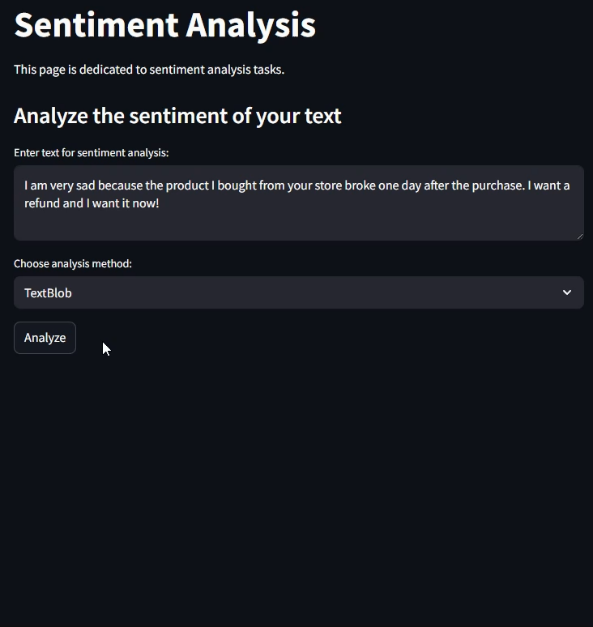
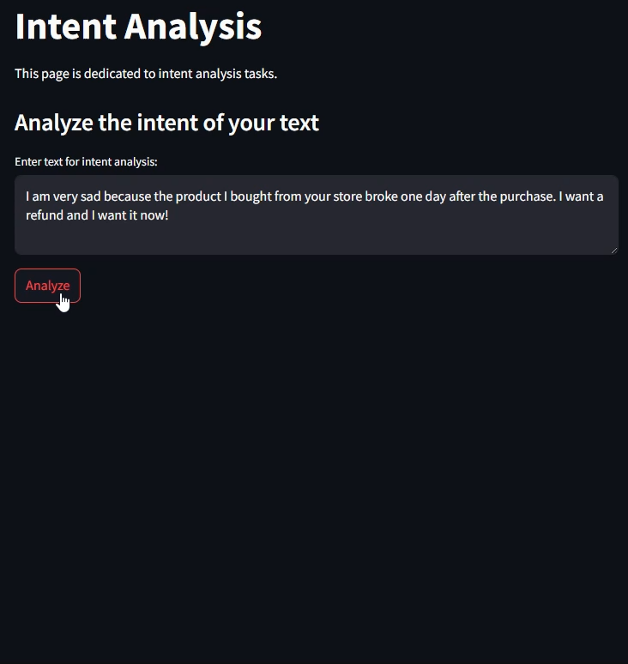
Understanding Emotions and Intentions
Sentiment Analysis textblob & OpenAI API
Intent Analysis OpenAI API

Slide 10
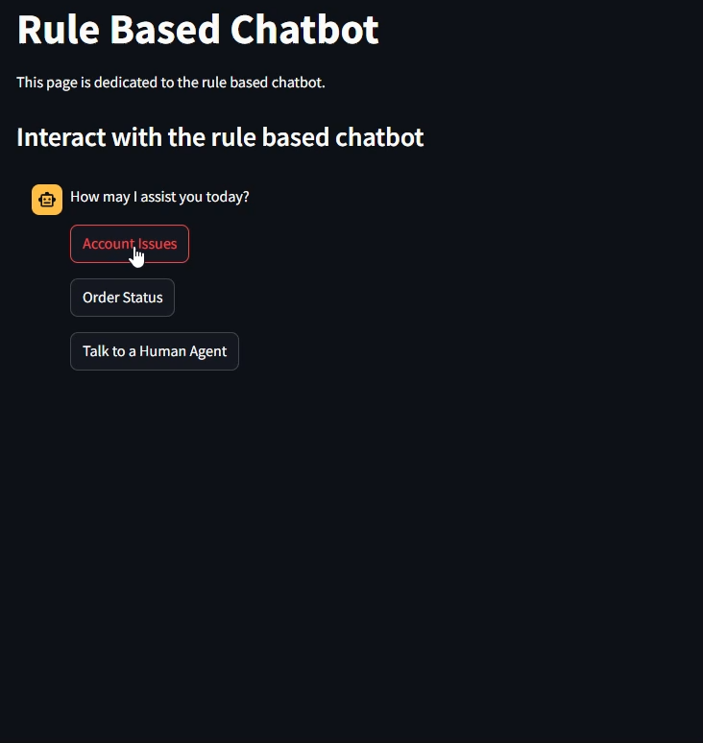
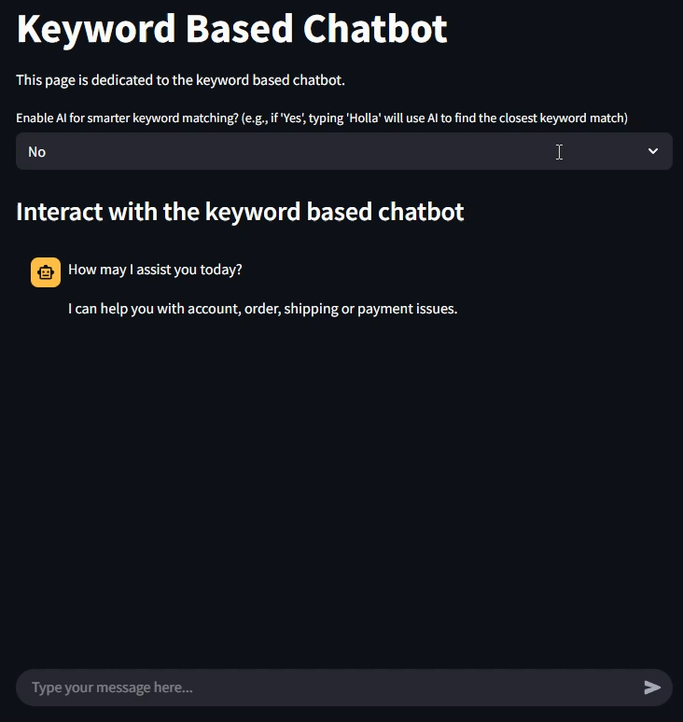
Simulating Early AI Support Models
Rule-based chatbot Hard-coded logic
Keyword chatbot Basic NLP & typo handling

Slide 11
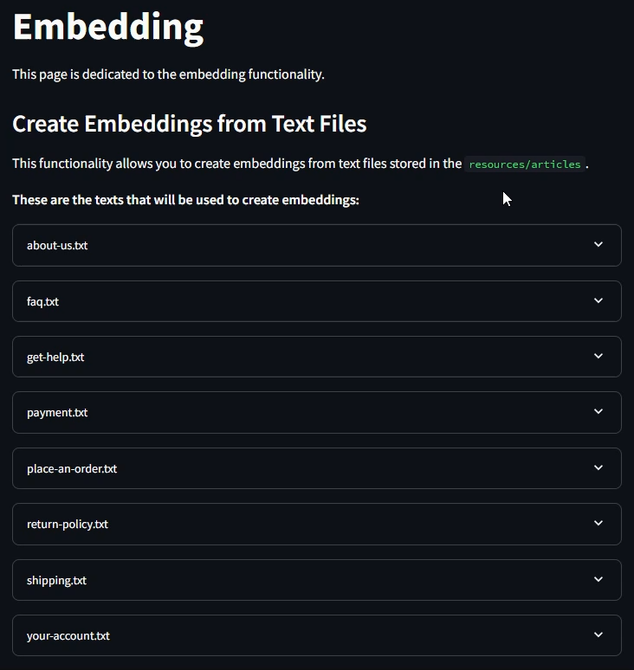
Understanding Meaning with Embeddings
OpenAI API (embeddings)
FAISS (vector search)
Groups semantically similar articles together

Slide 12
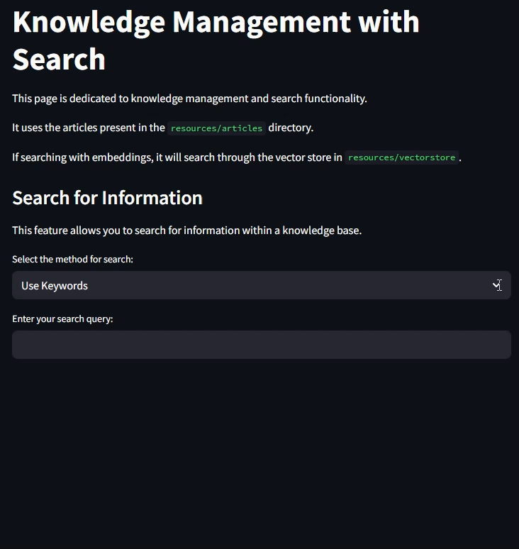
Smart Knowledge Retrieval
OpenAI API (embeddings)
FAISS (vector search)
Semantically similar results, not exact keyword matches

Slide 13
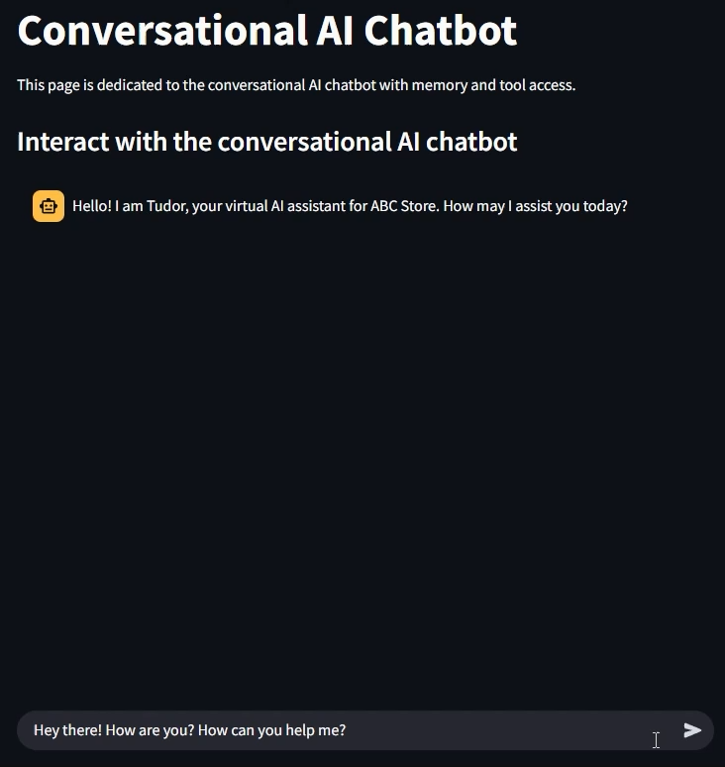
Memory-Aware and RAG Chatbot
LanghChain
Memory & Tools (RAG)
Retains context across messages and uses tools
User Input
AI Response
LLM Invocation
Knowledge Retrieval
Prompt Composition
FAISS
RAG
History
Knowledge
Input
System
LangChain

Slide 14
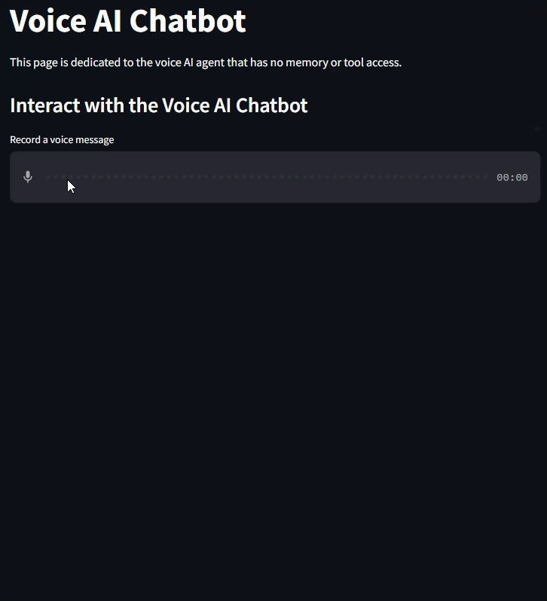

Speak with AI – Voice Chatbot
OpenAI API
Whisper
Spoken conversations and replies with synthesized voice
User Speech
Audio Response
Speech Synthesis (TTS)
Text Generation (LLM)
Transcription (STT)
Based on text emotion
Whisper
OpenAI API

Slide 15
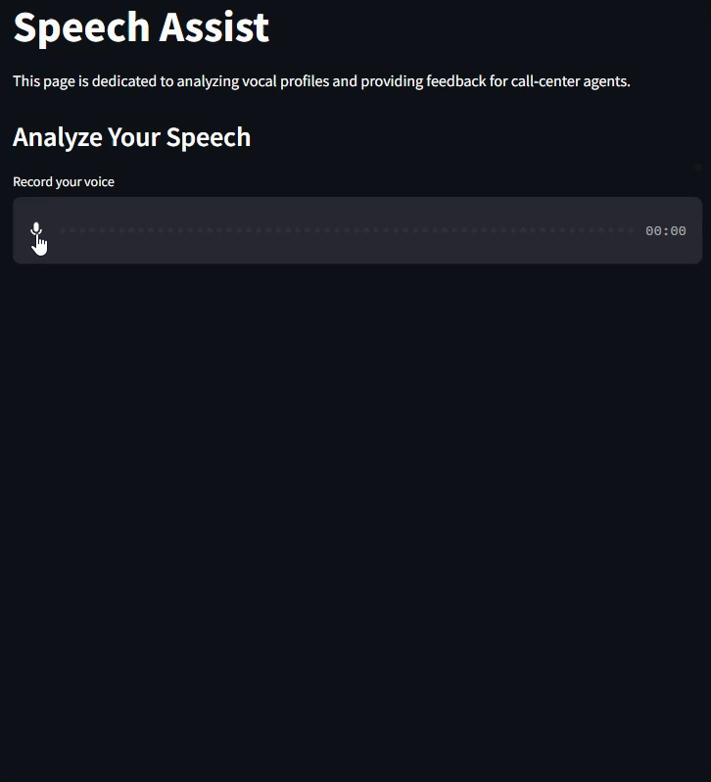
Real-Time Agent Coaching
parselmouth
OpenAI API
Evaluates speech to provide real-time feedback to agents
Voice Input
Acoustic Analysis
parselmouth
Transcription
OpenAI STT
Processing
Feature Extraction
WPM
Feedback Output

Slide 16
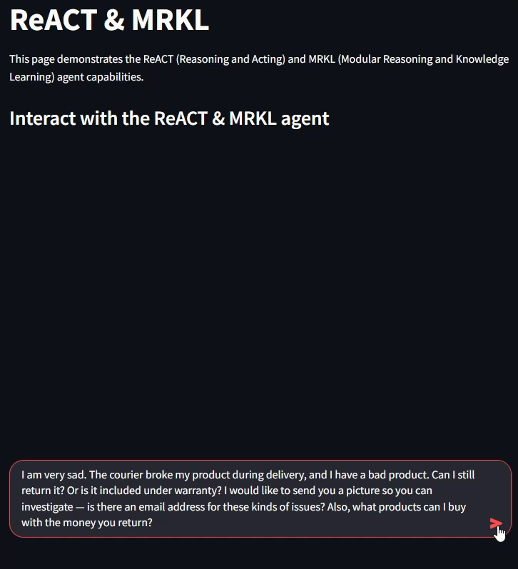
Complex Problem-Solving Agentic AI Chatbot
LanghChain & LangGraph
Memory & Tools & Reasoning
Solves complex, multi-step tasks with autonomy
Step | Description
Question | The original user input, possibly containing multiple sub-questions.
Thought | The agent’s internal reasoning about what information or tools it needs.
Action | The specific tool the agent decides to use (e.g., a search or API call).
Action Input | The argument or query provided to the selected tool.
Observation | The output returned by the tool, used as evidence or context.
Thought (updated) | The agent reassesses what it knows after reviewing the tool's output.
Final Answer | A comprehensive, formatted response delivered to the user.
Repeats until task is done

Slide 17
Discussion & Conclusions
AI Is Reshaping Support
Real-world case studies and prototypes confirm AI’s impact on speed, cost, and CX.
Chatbots, voice tools, and knowledge systems are the most common and high-impact applications.
Multi-Model Integration
LLMs, embeddings, ASR, and APIs work best when orchestrated together.
Modular setups (e.g., LangChain, LangGraph) reflect real-world industry practice.
Challenges Remain
AI still struggles with empathy, ambiguity, and complex human nuance.
Over-automation can hurt trust if not supported by smooth human handoffs.
Modular Tools Drive Progress
The best systems combine specialized tools: retrieval, reasoning, voice, and more.
AI is now incredibly affordable as many tools are open-source, APIs cost fractions of a cent, and even small teams can build advanced systems.
Conclusion
AI is a practical, scalable asset, not a distant dream.
The future lies in agentic copilots: smart, ethical, and designed to enhance – not replace – humans.

Slide 18
Thank You!
AI is not here to replace us.
It's here to empower us.

